Slide 1
Graduation Reports Information Sharing
1:30 – 2:30 PM PST
Conference Call Info: 1-866-365-4409
Access Code: 9842401#
*6 to mute your phone, *7 to unmute

Slide 2
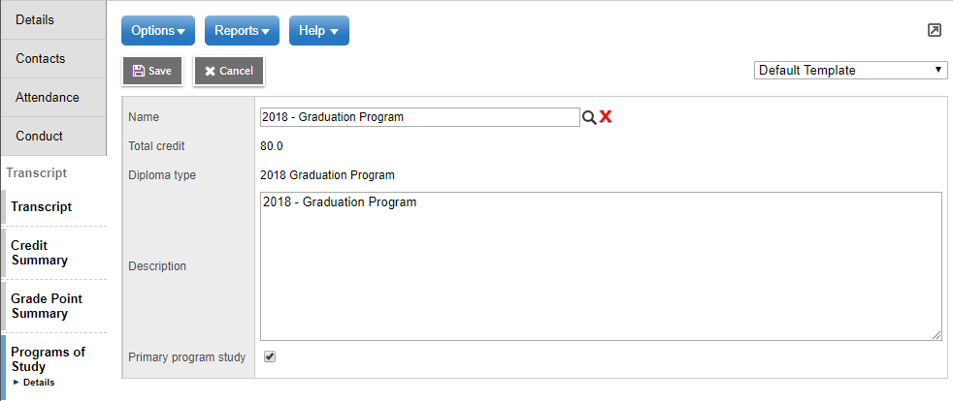
Primary Program of Study
The Primary Program of Study assigned to the student determines the Graduation Program. These changes apply to students with the 2018 Graduation Program.

Slide 3
Transitional Time
Bridging from old to new courses and assessments over the next couple of years
Some courses and requirements are not yet open and available for students
Temporary overlap – closing courses
Literacy Assessment
Questions on the Grad Programs
Communications from TRAX/Certifications
Handbook of Procedures https://www2.gov.bc.ca/assets/gov/education/administration/kindergarten-to-grade-12/graduation/handbook_of_procedures.pdf
Contact: trax.support@gov.bc.ca

Slide 4
2018 Graduation Program Reports
2018 Graduation Program Reports display six new graduation requirements:
Career Life Education
Career Life Connections
Arts Educ/Applied Design, Skills and Technologies
Physical and Health Education 10
Numeracy Assessment
*Literacy Assessment (*future)

Slide 5
New Requirement Codes Display
These requirements display on reports in a familiar way using alpha (DVR) or numeric (School Transcript Report) codes
AST (11) - Arts Educ/Applied Design, Skills and Technologies
CLC (13) - Career Life Education
CLE (12) - Career Life Connections
PHO (10) - Physical and Health Education 10
These requirements display in a new area
NMA (16) – Numeracy Assessment
*LTE – Literacy Assessment *future

Slide 6
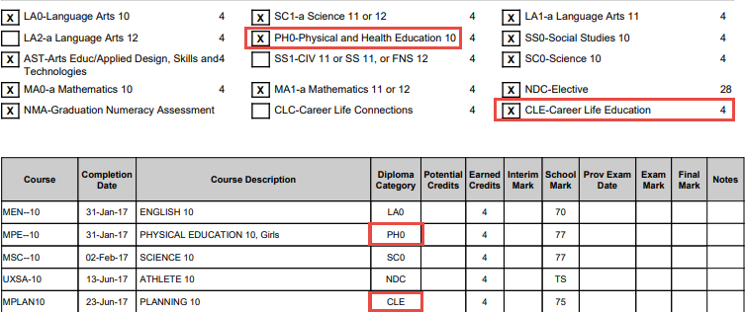
DVR – AST, CLC, CLE, PH0
Requirement boxes are checked for courses successfully completed (passing final mark and completion date), or currently in progress. The alphabetical diploma code displays in the Diploma Category column.

Slide 7
DVR – Graduation Assessments
Graduation Assessments box displays when the student has written an assessment or a transitional equivalent course. All graduation assessment records display on the DVR.
One Assessment Written:
Multiple Assessments Written:

Slide 8
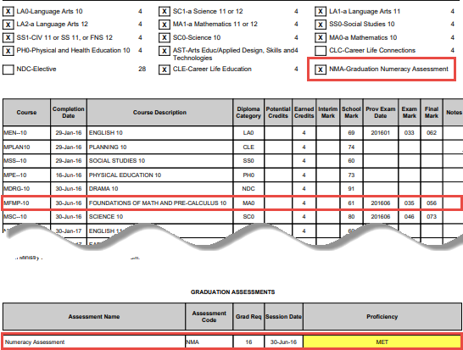
DVR Transitional
Student has successfully completed an examinable Math 10 and has not written a Numeracy Assessment

Slide 9
School Transcript Report – AST, CLC, CLE, PH0, NMA
The numeric diploma code displays in the Diploma Category column for successfully completed courses (passing final mark and completion date)
The Graduation Assessment record with the highest score displays

Slide 10
School Transcript Report Transitional
Student has successfully completed an examinable Math 10 and has not written a Numeracy Assessment

Slide 11
2018 School Transcript Legend

Slide 12
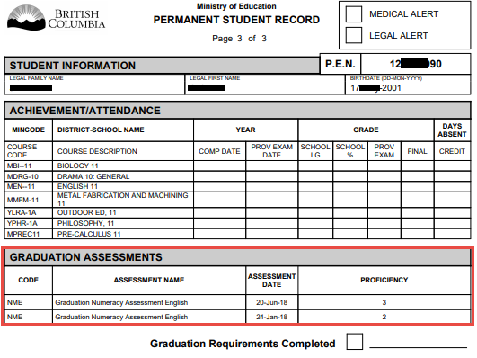
PSR – Graduation Assessment
All Graduation Assessment records display at the end of the PSR

Slide 13
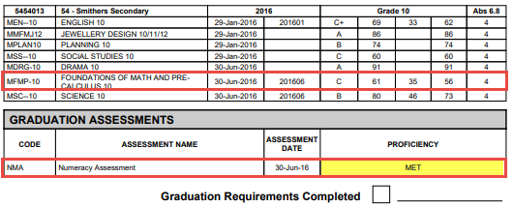
PSR - Transitional
Student has successfully completed an examinable Math 10 and has not written a Numeracy Assessment

Slide 14
PSR – Graduation Requirements Met
PSR does not calculate graduation requirements. The Graduation Requirements checkbox and date field are populated by the date entered in the the student details > Dip/SCCP Date field

Slide 15
Requirement Determination Change
Requirement determination change will apply to all diploma types on both the DVR and School Transcript Report
TRAX
MyEdBC
When multiple courses meet both a core requirement and elective requirement, the course with the highest mark is determined to meet the core requirement
When multiple courses meet both a core requirement and elective requirement, the course completed first is determined to meet the core requirement

