Slide 1
Pre-Transition & Preparation for EOYR
Start time: 10:00 AM
You can use the following numbers to dial in:
Victoria: 1-778-401-6245 | Vancouver: 1-604-449-4460
Kelowna: 1-236-361-9865 | Whitehorse: 1-867-457-0197
Conference ID: 429 103 840 781 58
During the calls, press *6 to mute your phone, or *7 to un-mute
To preview the slides: use the navigation arrows at the top left and use click to presenter when done
April 9, 2026

Slide 2
What are we talking about today?
What is Pre-Transition?
Pre-Transition Workflow
Pre-Transition Reminders
Student Movement Grid
Pre-Transition Support
Intro to EOYR Support Session – Friday, May 8th

Slide 3
What is Pre-Transition
Pre-Transition is student data prep for the End of Year Rollover process in August
Using specific fields in the student demographics.
The data tells the EOYR process what should happen with a student during transition
Some fields facilitate next year prep
Next Homeroom
Next School Value
To be Graduated
Withdraw
Notes:
Data prep – graduate your seniors, Update Next School field and Mass update students returning to the same school, Flag for withdraw at EOYR for students not returning
Fields – Next School, Next Homeroom (District Process), Diploma/SCCP date for graduating students, Pretransition Withdrawal Code

Slide 4
Pre Transition
Student Movement
Preparing for next year
Graduating your Grade 12’s
Advancing your grade levels for primary and Intermediate grades
Preparing EL’s for entry into Kindergarten
Next Year Filter – what it looks like for next year, this data changes continually until the EOYR process
Notes:
You do not own a student record until they are ACTIVE in your school

Slide 5

What is EOYR?
End of Year Rollover runs for one week in August. Aug 8th - 17th.
Student Records are adjusted per the settings in the EOYR – Student Transitions field set at the school level.
School View > Student Top Tab > Field Sets > EOYR – Student Transitions
EOYR
  Graduate students runs first
  Runs next on students with an enrollment status of Active and Active No Primary
Notes:
EOYR – Little Joey is in Kindergarten right now and will moving to an out of catchment Elementary School. What will it look like after EOYR process?
Graduates students with these three indicators in place:
Enrolment Status of Active or Active no Primary
YOG=2026

Slide 6
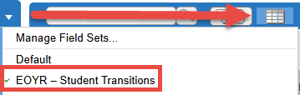
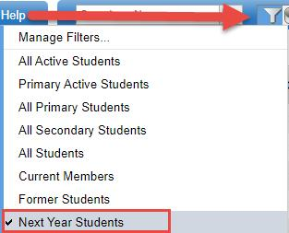
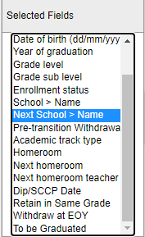

Pre-Transition Workflow Tools
Current year EOYR-Student Transitions Fields
Current Year
Next Year Students Filter
Current Year
Data Validation
EOYR Filter
Current Year
Run a Quick Report of your Next Year Enrollments
EOYR Process runs, transition is complete
Notes:
EOYR – Student Transitions
Filters
Next Year Students – Students with the field entered at the school level
EOYR filter– checking data will not stall EOYR process or create bad data
Report -

Slide 7
District Pre-Transition Workflow
Working the List
Schools gather information from families and students: Enter data and validate
Districts communicate any concerns to schools and confirm data
Districts review and validate data
Fujitsu notification of Fatal Error items

Slide 8
Student Transition Reminders
Primary Schools are responsible for the Student Transition setting data
Student Transition settings are used in End of Year Rollover (EOYR) and for Build view Scheduling
Setting accuracy for each student is important
  student ends up in the correct school(s)
  with the correct enrollment status

Slide 9
EOYR – Student Transitions Field Set
Values in many columns of the Pre-Transition field set are static and carry forward year after year.
The values must be validated for accuracy for the coming End of Year Rollover.
Schools/Districts may choose to mass update or delete the information prior to starting the Student Transition process.

Slide 10
EOYR – Student Transitions Field Set
Mass Update and Modify List functions can only be performed on Primary Active students. Set the filter to Primary Active Students if you intend to use these functions.
Only one EOYR Transition drop-down per student
Cannot use Next School field and Withdraw drop-down

Slide 11
Grade 12 Students
NextSkl > Name: Only populate for a grade 12 student who is moving to another primary school next year.
NextHomeroom: Not applicable to grade 12 students who are graduating.
EOYR Transition: Choose one; Graduate, Retain or Withdraw (see next slide).
Diploma/SCCP Date: This field can be populated for Grade 12 students who are graduating or students completing their Evergreen Certification. This date prints on the PSR card for Graduation Requirements Met. There may be students in the list who already have a date populated and have returned to take additional courses.
Notes:
* Only one of these settings may be used for a student at EOYR, and not all students will require one of these settings.

Slide 12
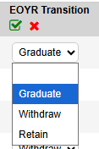
Movement Flag Fields
Retain*: Use this drop-down only if a student is to be retained in the same grade and the EOYR process will add a year to the student YOG.
Withdraw*: Using this drop-down is not necessary for students who are in Grade 12 and are graduating, the ‘Graduate’ drop-down is also a withdrawal.
Graduate*: Check this box for all graduating students not returning or continuing in another school.
Notes:
Selecting more than will result in a fatal error and you will be notified by the Service Desk to change data
Caution these flags do not get reset at EOYR so checking all students is necessary. TIP to click column header to sort for Y or N

Slide 13
Next School Name Field
This is where the student will end up after EOYR
Recommendation to remove NextSkl>Name from student record if the student is withdrawn from current school before EOYR
This field reflects and projects enrollment numbers for next year for your school and students being pre-transitioned from another school to you.
  This field can be changed by schools that own that student anytime before EOYR.
Graduating Students should not have a Next School
Notes:
Make sure you check your numbers frequently

Slide 14
Pre-Transition Reminders
Next School Field is admitting next year
    If the student is moving out of Province DO NOT enter an OOP school in Next School
Student pre-transitioned to feeder school - get a request for another school, do not change Next Year School till you talk to feeder school so they can remove next year courses.
Next Year Secondary Associations are required for scheduling purposes, need to review membership records
    Global Top Tab > Favorite Side Tab > Student School Association
Notes:
Next Year Associations - Review the records in the list and note records that do not have an End Date.
Populate the End Date to a date on or before the current year Enterprise calendar year end field to ensure the association is ended through EOYR.

Slide 15
EOYR Workflow
Schools enter specific Student Demographic settings for Primary Active students (Apr-Jun)
Districts validate and confirm data
  Fix or communicate to schools
Fujitsu Helpdesk communicates EOYR Fatal Errors (starting mid-June)
Districts validate and confirm data. Must be completed before start of EOYR
  Fix or communicate to schools
EOYR Process transitions students based on the entered data

Slide 16
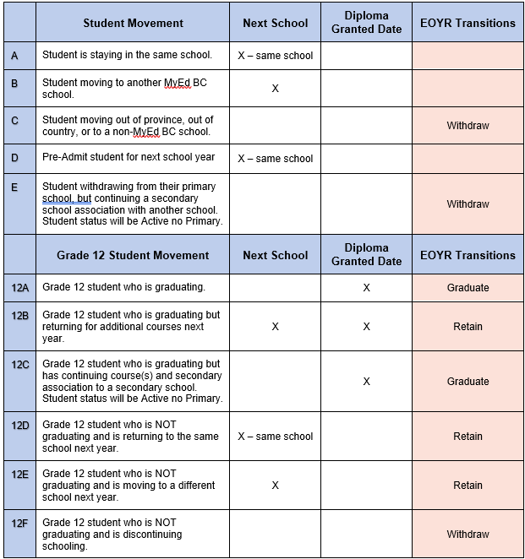
Student Movement Scenarios Grid
Notes:
Next School and a flag or you will get an error

Slide 17
Use the Grid – Share the Grid
Where is the Student Movement Grid?
    MyEducationBC.info > School User Resources > End of Year Rollover
      Section 2.5 - Student Movement Scenarios
  L1 Information Station > Resources and Recordings > EOYR and Pre-Transition > EOYR Student Movement table only
      Word version of Grid
      Districts can customize and distribute

Slide 18

Questions and Answers

