Slide 1
MyEducation BC Standards Based Gradebook
September 2017

Slide 2
BC Model – A Hybrid
Report on learning using Traditional model
Assess learning using Reporting Standards

Slide 3
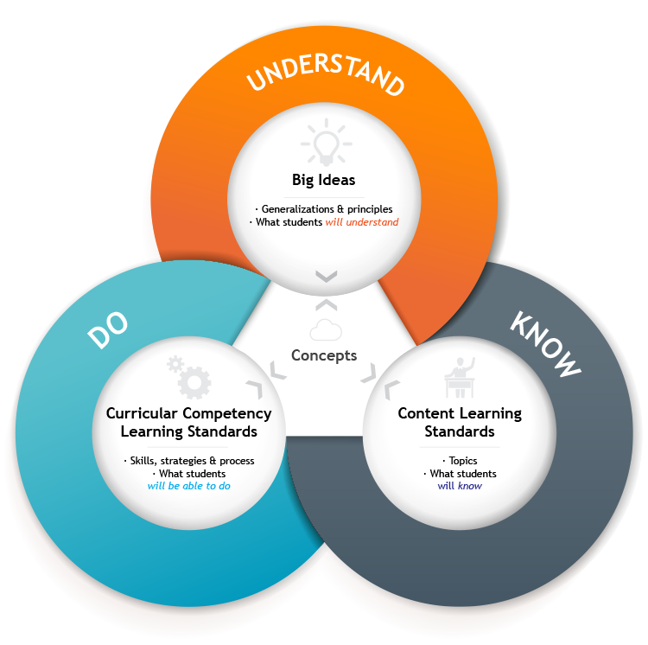
Why Standards Based?
BC’s redesigned curriculum is COMPETENCY BASED
BC’s redesigned curriculum is CONCEPT DRIVEN
BC’s redesigned curriculum is PERSONALIZED

Slide 4
Assessment Compared

Slide 5
Gradebooks
A Traditional Gradebook: Reporting First
2 dimensional
weighted/averaged gradebooks because “we’ve always done it that way”
How well informed?
A Standards Based Gradebook (SBG): Learning First
3 dimensional
Trend focus
Informs instruction
What did they learn?

Slide 6
What Does it Tell You?

Slide 7
Standards Based Assessment
Learning tasks are assessed against standards rather than “marked”.
Example from Mathematics 4
Communicate mathematical
thinking in many ways.
(pictorially, words,
symbolically, etc.)
“Answer this question as many ways as you can.”

Slide 8
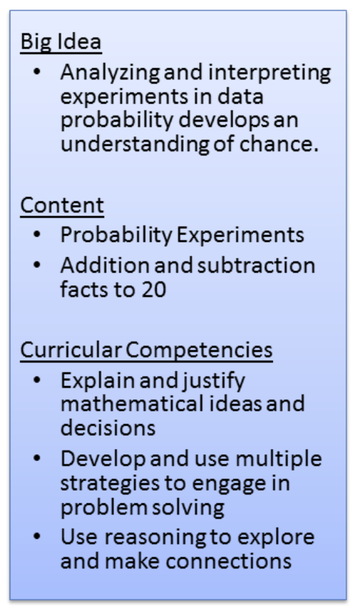
Odd or Even?
Notes:
An assignment created to assess COMPETENCIES.

Slide 9
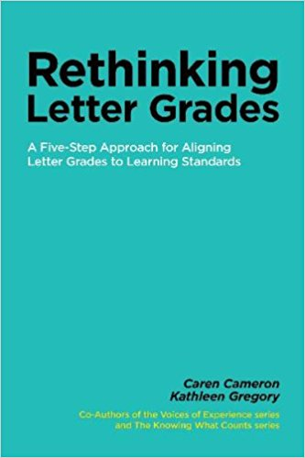
Letter Grades
Outlines an approach for working with proficiencies, standards and competencies
AND
Providing a final letter grade or even a percentage.
Helpful at both elementary and secondary!

Slide 10
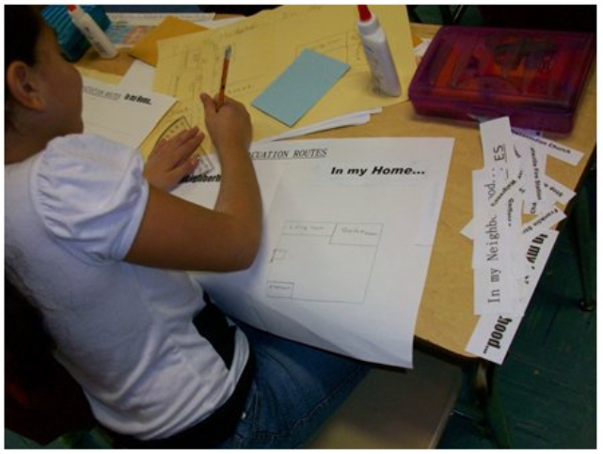
Standards Based Grade Book
Allows teachers to attach BC’s curricular competencies to learning tasks
Provides a comprehensive picture of student growth
Gives teachers a tool for
planning instruction for
the class and for individual
students
Let’s have a look!

Slide 11
Curricular Competencies

Slide 12
Categories
Only one category is required: Evidence of Learning
Notes:
Because learning tasks include competencies from many categories, a single bucket of evidence will show growth across all competencies.

Slide 13
Add an Assignment

Slide 14
Add an Assignment

Slide 15
Add Competencies

Slide 16
Student Growth

Slide 17
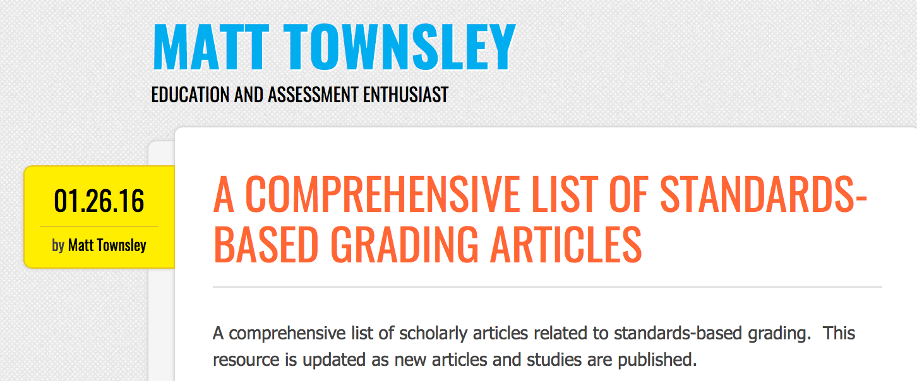
Further Reading
www.bit.ly/SBGLiterature

Slide 18
Questions

