Slide 1
Student Services Year Start Up
Start time: 10 AM
You can use the following numbers to dial in:
Victoria: 1-778-401-6245 | Vancouver: 1-604-449-4460
Kelowna: 1-236-361-9865 | Whitehorse: 1-867-457-0197
Conference ID: 447 421 960#
During the calls, press *6 to mute your phone, or *7 to un-mute
To preview the slides: use the navigation arrows at the top left and use click to presenter when done
August 30, 2023

Slide 2
This Session is being recorded
Please Mute your sound and turn off Video.
To ask questions you can:
Type in the Chat and we will read it out
Raise your hand and we will call your name
*7 to unmute to speak over phone or Teams.

Slide 3
Overview
What you need to know and where to find it
District Processes
What it looks like
Tips and Tricks
Troubleshooting
Did you know?
Documentation

Slide 4
After End of Year Process (EOYR)
No changes to student services records
Students arriving from feeder schools will remain enrolled in student services and their records intact
Only students withdrawn will be Exited and their IEP status changed to Previous
Students transitioning to a new school will NOT be Exited from Student Services

Slide 5
Student Services Roles
Student Services – District
Student Services – School
Student Services: Enroll & Read – School
Student Services: Read Only – District
Student Services: Read Only – School
Teacher (read only access to IEPs of their students)
1701 Designations

Slide 6
IEPs and CB IEPs - Plan Status
Plan status is determined by the dates
Plan Status | Start Date | End Date
ACTIVE | Current date | Blank
ACTIVE | Current date | Future Date
ACTIVE | Past date | Blank
ACTIVE | Past date | Future date
DRAFT | Future date | Blank
DRAFT | Future date | Future Date
PREVIOUS | Past date | Current date
PREVIOUS | Past date | Past date
DISCARDED | Current date | Current date

Slide 7
Strategies
Reviewing Plans
Active (Current) plans
Identify them
Name them
Update the start and end dates
Draft (Future) plans
Review them student by student
Determine whether to keep them or abandon them
Adjust the start and end dates accordingly

Slide 8
Strategies
Previous (Past) plans
Ensure that the end date is in the past
Plans with No Dates
Review them and determine whether they should be kept or discarded.
If kept – enter start and end dates
If discarded – manually delete or set plan status to Discarded.
Updating IEP Dates
Plan top tab > Filter = All Records > FieldSet = Default
The Start and End dates, the Plan Status and Plan Name are list-editable and mass-updateable

Slide 9
District Process and Recommendations
Naming Conventions
Assigning Designations
Renewing
Goals and Objectives
Progress Reports
Staff Records
Inclusive Ed Status

Slide 10
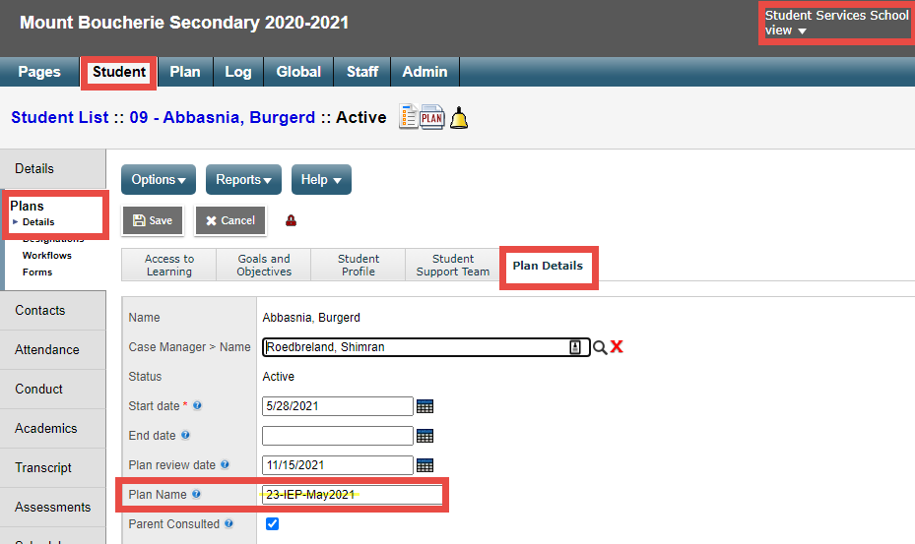
Naming Conventions for Plans
Suggested: District Number in the Plan Name Student Services School View > Student top tab > Plans side tab > Details leaf > Plan Details sub top tab

Slide 11
IEP Goal Progress Reports
Reports are designed to complete one report for each student objective
You must have at least one objective for each goal
Reports can be run/printed for individual students or for multiple students
Reports can be run when appropriate and are not directly linked to grade terms/reporting periods
Progress Reports are available to Districts using the BC IEP only; not the CB IEP

Slide 12
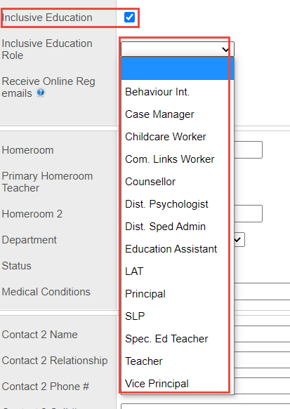
Staff Records
Staff will not show up in the Student Service pick lists if the staff record does not have the correct boxes checked
School View >
Staff top tab >
Details leaf
Notes:
Staff Records: Ensure all clerical staff knows to update Staff Records with the Inclusive Ed Status and role for the Staff member in order for the person to be available in the Student Services View picklists.

Slide 13
Supporting Tips & Tricks
Wrong grade or school on IEP
No Active IEP
Student Exited
Report Card Field Set (check the WD flag)
Student top tab > Filter = Primary Active > Field Set = Pre-transition
New to District students – re-enrolled
Designation dates (end dated, primary, secondary)
School View> Student top tab > Programs side tab
Notes:
Wrong grade or school on IEP: it’s almost always a date issue for the IEPs. Ensure the Start and End dates don’t overlap from Previous to Active to Draft (HINT – Sometimes looking at the Student tt and Membership st can help)
No Active IEP You can renew a previous IEP by manipulating the end date of a previous one to make it active and then renew +1 and +2
Student Exited – if a student has been withdrawn from a school:
either flagged to withdraw at EOYR (visible in the Pre-transition Field Set) or has been withdrawn from another district and is new to you, the student must be re-enrolled to the student services module
Filters are your friends; when staff members don’t see expected student records, Check All Records, Exited, etc.
Designation dates – especially important for 1701. If a student should be on the 1701 list and isn’t, check the end dates for the designations (ensure the correct designation is set to Primary)
Designations are visible in the School View> Student top tab > Programs side tab

Slide 14
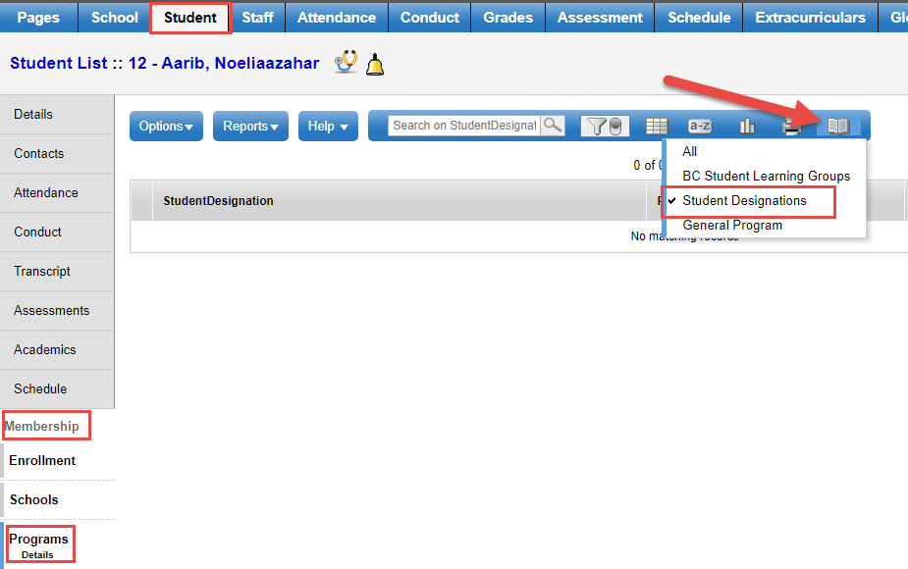
Supporting Tips & Tricks
Designation dates (end dated, primary, secondary)
School View> Student top tab > Membership side tab > Programs sub side tab > Data Dictionary

Slide 15
Did you know?
There is a filter that allows you to see Next Year students in the Student Services School View
Student top tab, Filter = Next Year Students
IEPs (read only) are accessible from
School View > Student > Documents > Plan
Teachers can see IEPs for their own students in Staff View
On the withdraw screen you can use the “Keep Student in Special Education” check box and this will retain the student in the Student Services Module. If you do not check this, the student will be Exited from Student Services when withdrawn

Slide 16
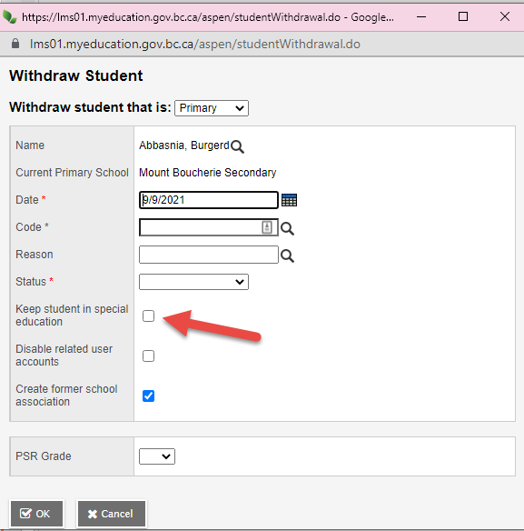
Did you know?
When withdrawing a student, you can use the “Keep Student in Special Education” check box
This will retain the student in the Student Services module as Active after being withdrawn.
District process
BC Standards

Slide 17
Documentation
MyEducationBC.Info site > Student Services Resources
1701 Student Services Designations
Competency Based Inclusive Education Plans (CB IEP)
Individual Education Plans

Slide 18
Questions and Answers

