Slide 1
Student Services Year Start Up
Start time: 1 PM
You can use the following numbers to dial in:
Victoria: 1-778-401-6245 | Vancouver: 1-604-449-4460
Kelowna: 1-236-361-9865 | Whitehorse: 1-867-457-0197
Conference ID: 447 421 960#
During the calls, press *6 to mute your phone, or *7 to un-mute
To preview the slides: use the navigation arrows at the top left and use click to presenter when done
August 28, 2025

Slide 2
This Session is being recorded
Please Mute your sound and turn off Video.
To ask questions you can:
Type in the Chat and we will read it out
Raise your hand and we will call your name
*7 to unmute to speak over phone or Teams.

Slide 3
Overview
What you need to know and where to find it
District Processes
What it looks like
Tips and Tricks
Troubleshooting
Did you know?
Documentation
Notes:
School View, Staff View and Student Services Views
Inclusive Ed Status Active and Exited
IEP Status Active Previous Draft
New Students to your district IEP vs CB IEP
In MyEducation BC, the Student Services module provides a simple interface that allows users to write support plans and review student progress. The module is flexible enough to align with district practice while capturing all the required data elements for the Student Plan.
There are two formats available for the purpose of documenting the services provided to students to support their education. The Individual Education Plan format and the Competency Based format. Districts, in partnership with their Student Services departments, can choose which format will be in use within their district. The form used will be a district wide commitment.

Slide 4
  After End of Year Process (EOYR)
No changes to student services records
Students arriving from feeder schools will remain enrolled in student services and their records intact
Only students withdrawn will be Exited and their IEP status changed to Previous
Students transitioning to a new school within the current district will NOT be Exited from Student Services
Notes:
Nobody gets dropped in EOYR
Student status Active vs Exited

Slide 5
Student Services Roles
Student Services – District
Student Services – School
Student Services: Enroll & Read – School
Student Services: Read Only – District
Student Services: Read Only – School
Teacher (read only access to IEPs of their students)
1701 Designations
Notes:
Roles are contingent on District and School processes and the roles assigned to users will be determined by how you do things:
As always when assigning roles, you assign the fewest number of permissions to the largest number of users and work backward from there. Ensure you are aware of the impact, who has had or needs training.
Training is an essential component of all district and school processes. It is imperative to emphasize the importance of and the responsibility involved in having access to information and the ability to make changes to access.

Slide 6
1701 Designation Role
MyEducation BC provides 1701 Designation Programs for students eligible to receive 1701 Student Services Supplementary Funding in the students’ primary schools.
The Primary Designation Program will populate the field 1701 Designation in Student Demographics and display on all reports and exports related to 1701 or Student Services.
Notes:
Documentation - 1701 Student Services Designation Programs – MyEducationBC.Info site under Student Services Resources

Slide 7
1701 Designation
A student can only have ONE primary Ministry Designation for funding purposes.
From the School view > Student top tab students who have a Ministry Designation can be displayed using the Active w/ Designation filter.
Schools can also run the BC 1701 Student Services report located in Student top tab > Reports menu > Ministry Reporting.
Notes:
One of the biggest responsibilities of an L1 is assigning roles to your users. Roles are always contingent on district and school processes. Roles assigned to your users will be determined by how you do things. For instances, if you have a centralized designation process your 1701 Designation Role allows your user to assign to designations to students all across your district. That’s a huge responsibility and there is a lot riding on the accuracy of the assignment of designations in terms of 1701 funding. So use extreme caution when assigning this role to users and make sure you are adhering to your district process around that. A lot of districts I know, they centralize control of that one function just to maintain the accuracy of the information that is entered into MyEducation BC. As always when assigning roles you assign the fewest amount of permissions to the largest group of users and work backwards from there. So just make sure you are aware of the impact, who has and who hasn’t had training and who needs to have it. Training is such a huge piece of every district and school process and it is so important to emphasize the importance and responsibility around having access to information and the ability to make changes to it. So given that, your Student Services – District, your Student Services – School, have a look at the documentation and make sure you are assigning the right role to the right people so that they can do only what they need. The teacher role will give every teacher access to IEPs for their students so they will be able to read. In School View you can always view an IEP for a student.

Slide 8
1701 Designation Role
1701 Designations
  Add On Security Role
  District Users, Clerical, Staff
  Views - District, School
The 1701 Designations role allows the user to assign designations to students.
  In most Districts, this is a huge responsibility and there is a lot riding on the accuracy of the assignments in terms of 1701 funding.
  Use caution assigning this role to users.
Notes:
The Security add-on role, 1701 Designations is needed to add, edit or change 1701 funding programs for Student Services Designations, assuming the following pre-requisite security is enabled:
•Users must have access to edit Student Program Participation
•Users already have access to School or District view.

Slide 9
IEPs and CB IEPs - Plan Status
Plan status is determined by the dates
Plan Status | Start Date | End Date
ACTIVE | Current date | Blank
ACTIVE | Current date | Future Date
ACTIVE | Past date | Blank
ACTIVE | Past date | Future date
DRAFT | Future date | Blank
DRAFT | Future date | Future Date
PREVIOUS | Past date | Current date
PREVIOUS | Past date | Past date
DISCARDED | Current date | Current date
Notes:
Once a student is enrolled in the Student Services module, they will have a status of Active,

Slide 10
Strategies
Reviewing Plans
  Active (Current) plans
    Identify them
    Name them
    Update the start and end dates
  Draft (Future) plans
    Review them student by student
    Determine whether to keep them or abandon them
    Adjust the start and end dates accordingly
Notes:
These tasks are generally for the staff such as the case managers in the schools. For each student in their caseload, they will need to go through the Active, Draft, Previous, and Plans with no Date and update them with correct dates and information
Student Services View- Plan Top Tab – Use the filter

Slide 11
Strategies
  Previous (Past) plans
    Ensure that the end date is in the past
  Plans with No Dates
    Review them and determine whether they should be kept or discarded.
    If kept – enter start and end dates
    If discarded – manually delete or set plan status to Discarded.
Updating IEP Dates
  Plan top tab > Filter = All Records > FieldSet = Default
  The Start and End dates, the Plan Status and Plan Name are list-editable and mass-updateable
Notes:
You can update the IEP dates in the Plan top tab

Slide 12
District Process and Recommendations
Naming Conventions
Assigning Designations
Renewing
Goals and Objectives
Progress Reports
Staff Records
  Inclusive Ed Status
    Must be set on the staff record so that the staff record is populated in the pick list(s) within the Student Services Module
Notes:
Communication and training!
Process drives how you Add, Modify, Update, and Delete information. Communication and training are your best friends.
Identify your process
Communicate it to your staff
Training follows
Enforcement and accountability
Naming conventions : we suggest using the school district number in your IEP or CBIEP naming conventions. It makes it really easy for the next district, if a student gets transferred, to identify which plans were written and developed by your staff in your district. So adding your district number to your IEPs or CB IEPs is a great visual clue for everybody.
Assigning Designations: Check roles and training for necessary users
Renewing: what is the criteria for a renewal? When? How often? Who?
PRESERVE THE AUDIT TRAIL
Goal Banks to use or not to use? There is a process to be identified and followed that needs some upfront setup and data entry if you are going to use them.
Progress Reports: Are you going to use them? How? When? Who? They can be used independently of the reporting or grade terms. Currently Progress Reports are available for use with the BCIEP and not the CBIEP.
Staff Records: Ensure all clerical staff knows to update Staff Records with the Inclusive Ed Status and role for the Staff member in order for the person to be available in the Student Services View picklists.

Slide 13
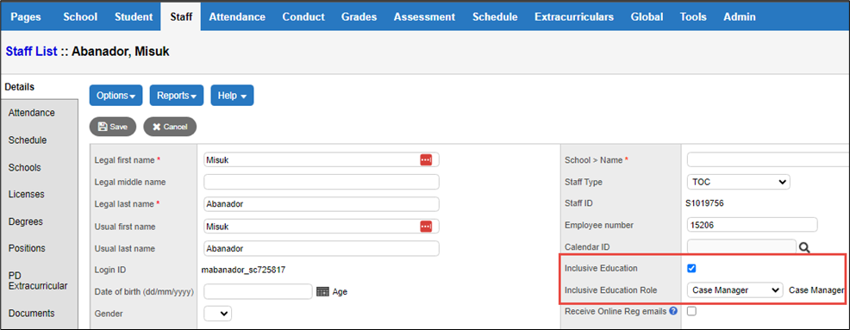
Staff Records
Staff will not show up in the Student Service pick lists if the staff record does not have the correct boxes checked
  School View > Staff top tab > Details leaf
Notes:
Staff Records: Ensure all clerical staff knows how to update Staff Records with the Inclusive Ed Status and role for the Staff member in order for the person to be available in the Student Services View picklists.
Checking Inclusive Education displays the staff member in the team member pick list.
Selecting an Inclusive Education Role identifies this for the staff member and populates the role field in the Student Support Team tab of the Student Plan.

Slide 14
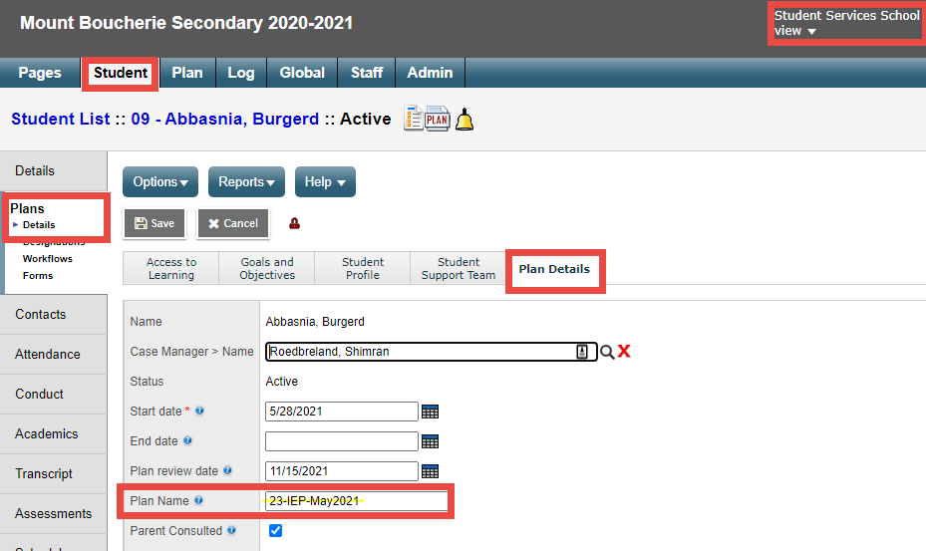
Naming Conventions for Plans
Suggested: District Number in the Plan Name
Student Services School View > Student top tab > Plans side tab > Details leaf > Plan Details sub top tab

Slide 15
IEP Goal Progress Reports
Reports are designed to complete one report for each student objective
  You must have at least one objective for each goal
Reports can be run/printed for individual students or for multiple students
Reports can be run when appropriate and are not directly linked to grade terms/reporting periods
Progress Reports are available to Districts using both BC IEP or CB IEP.

Slide 16
Supporting Tips & Tricks
Wrong grade or school on IEP
No Active IEP
Student Exited
  Report Card Field Set (check the WD flag)
    Student top tab > Filter = Primary Active > Field Set = Pre-transition
  New to District students – re-enrolled
Designation dates (end dated, primary, secondary)
  School View> Student top tab > Programs side tab
Notes:
Wrong grade or school on IEP: it’s almost always a date issue for the IEPs. Ensure the Start and End dates don’t overlap from Previous to Active to Draft (HINT – Sometimes looking at the Student tt and Membership st can help)
No Active IEP You can renew a previous IEP by manipulating the end date of a previous one to make it active and then renew +1 and +2
Student Exited – if a student has been withdrawn from a school:
either flagged to withdraw at EOYR (visible in the Pre-transition Field Set) or has been withdrawn from another district and is new to you, the student must be re-enrolled to the student services module
Filters are your friends; when staff members don’t see expected student records, Check All Records, Exited, etc.
Designation dates – especially important for 1701. If a student should be on the 1701 list and isn’t, check the end dates for the designations (ensure the correct designation is set to Primary)
Designations are visible in the School View> Student top tab > Programs side tab

Slide 17
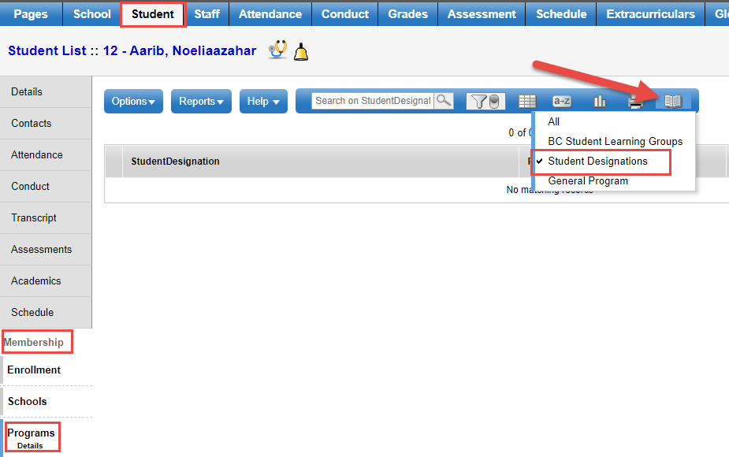
Supporting Tips & Tricks
Designation dates (end dated, primary, secondary)
  School View> Student top tab > Membership side tab > Programs sub side tab > Data Dictionary
Notes:
Designation dates – especially important for 1701. If a student should be on the 1701 list and isn’t, check the end dates for the designations (ensure the correct designation is set to Primary)
Designations are visible in the School View> Student top tab > Programs side tab

Slide 18
Bulk Exit Student from Student Services
Student Services District > Student TT > Options > Bulk Exit Students from Student Services
Users with the Student Services – Organization role can select a group of students to be discontinued from Student services by using this procedure. The Student Services Status for these students changes from Active to Exited and the Plan changes from Active to Previous.
If a student or group of students is exited in error, they can be manually re-enrolled in Student Services. The student Plan remains intact and can be set to active once the student is Active again in Student Services.

Slide 19
Did you know?
There is a filter that allows you to see Next Year students in the Student Services School View
  Student top tab, Filter = Next Year Students
IEPs (read only) are accessible from
  School View > Student > Documents > Plan
Teachers can see IEPs for their own students in Staff View

Slide 20
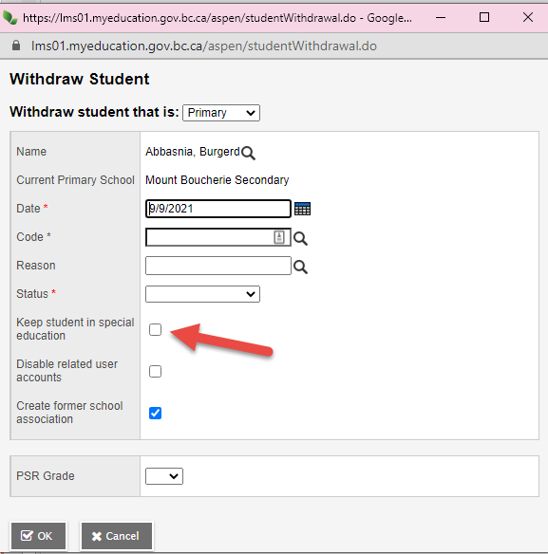
Did you know?
When withdrawing a student, you can use the “Keep Student in Special Education” check box
  This will retain the student in the Student Services module as Active after being withdrawn.
  District process
  BC Standards
Notes:
On the withdraw screen you can use the “Keep Student in Special Education” check box and this will retain the student in the Student Services Module. If you do not check this, the student will be Exited from Student Services when withdrawn
BC Standards are to Exit students from Student Services when the student is moving out of District. This functionality should not be used for students moving out of District.
will drive this functionality. Some districts may want to look at any new student coming and have the option to re-enroll each student new to their district

Slide 21
New and Improved
The Additional Comments section of the Support and Plans tab in a CB-IEP has been updated to support more than 500 characters
Updated all Special Education and SPED references in MyEd BC and supporting user documentation to reflect current terminology: Inclusive Education and IncED.

Slide 22
Documentation
MyEducationBC.Info site > Student Services Resources
  1701 Student Services Designations
  Competency Based Inclusive Education Plans (CB IEP)
  Individual Education Plans
Notes:
You can find documentation on the MyeducationBC Info site under Student Services Resources
We’ll update the site with the recording and other documentation after today’s presentation

Slide 23

Questions and Answers

