Slide 1
Supporting the New Curriculum in MyEducation BC
September 2016
Judy.L.Smith@gov.bc.ca

Slide 2
Topics
Guiding Principles
Rubric Scales
Learning Standards
Standards Based Grade Book
New standards based summative report
Using existing report cards to support the new curriculum

Slide 3
Guiding Principles
“Rather than focusing on formal and informal reporting to parents, reporting will be timely and responsive throughout the year following district policies and procedures.
Reporting must include a written summative report at the end of the school year or semester.”
“Board policies and procedures will determine the use of letter grades on summary reports. Boards will provide letter grades to parents upon request.”
Interim Student Reporting Guidelines for Grade K-9

Slide 4
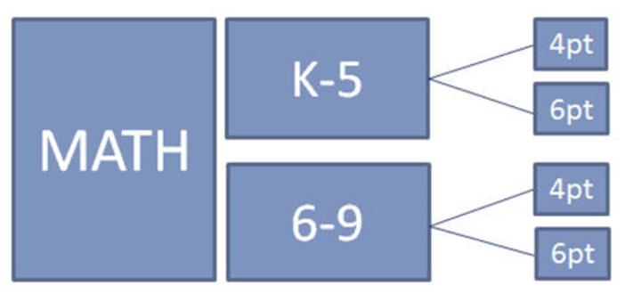
Ministry Rubric Scales
Used in both the standards based grade book and on summative reports.
4 pt. scale
NYM – AE – ME – EE
(K-9 all areas of learning)
6 pt. scale
F C- C C+ B A
(4-5 ELA, MA, SC, SS)
(6-9 PHE, AE, ADST, CE)

Slide 5
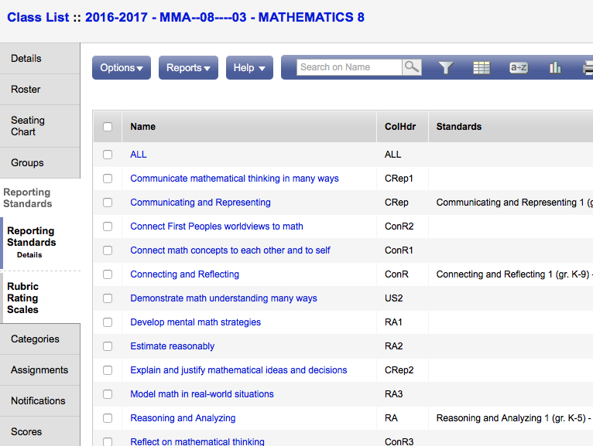
Learning Standards
Curricular Competencies
are loaded in the
Reporting
Standards
area of the
application
for all areas
of learning.

Slide 6
Standards Based Assessment
Learning tasks are assessed against a standard rather than “marked”.
Example from Mathematics 4
Communicate mathematical
thinking in many ways.
(pictorially, words,
symbolically, etc.)
“Answer this question as many ways as you can.”

Slide 7
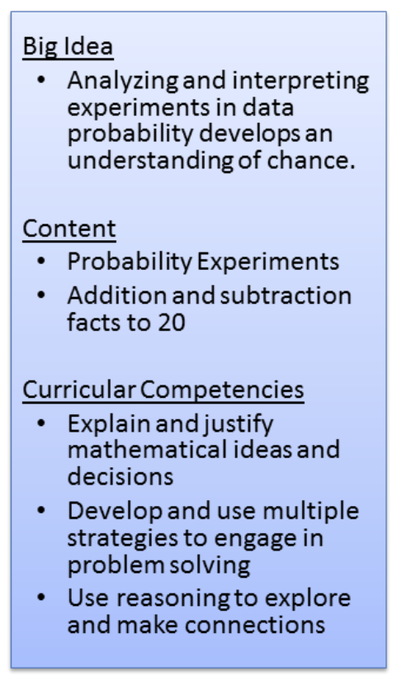
Odd or Even?
Notes:
An assignment created to assess COMPETENCIES.

Slide 8
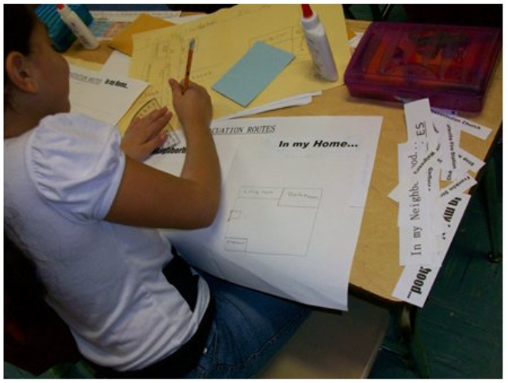
Standards Based Grade Book
Allows teachers to attach learning standards to assignments
DEMO: creating an
assignment
DEMO: pre filled
grade book

Slide 9
Curricular Competencies

Slide 10
Categories
Only one category is required: Evidence of Learning
Notes:
Because learning tasks include competencies from many categories, a single bucket of evidence will show growth across all competencies.

Slide 11
Add an Assignment

Slide 12
Add an Assignment

Slide 13
Add Competencies

Slide 14
Student Growth

Slide 15
Development of the Summative Report
Communicating Student Learning Working Group
13 districts – metro and rural, small, medicum & large; Learning Division staff; teachers, principals, and district administrators - Elementary, Middle Years, Secondary
Biweekly meetings for 10 months
Learned from the IB Pilot Project

Slide 16
New Summative Report
Flexible
Allows many different configurations
Can be used at any time for all students or single students

Slide 17
Existing Report Cards
Using a Proficiency Scale Only
Primary Report Card
Intermediate Report Card
Mix of Letter Grades & Proficiency Scale
Intermediate Report Card
Letter Grades Only
Intermediate Report Card
Middle Years Report Card

Slide 18
Questions

